Slide 1
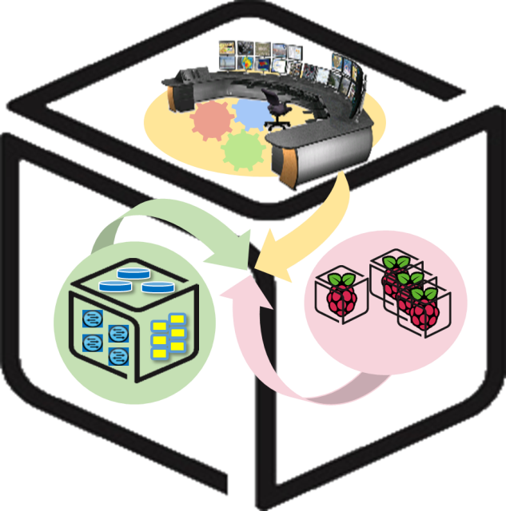
SmartX Labs for Computer Systems
InterConnect Lab v0.6
(2016, Spring)
NetCS Lab

Slide 2
History and Contributor of InterConnect Lab
(2016. 07. 03)
Version | Updated Date | Updated Contents | Contributor
- | 2016/04 | (구) InterConnect Lab 최종본 작성 | 김 승 룡
v0.1 | 2016/04 | 단어 교정 및 그림 추가 및 수정, RPi(SNMP, SmartX-mini) 설치 부분 추가 | 김 철 원
V0.2 | 2016/05 | History 작성 | 김 철 원
V0.3 | 2016/05 | 슬라이드 제목 및 순서 수정, 이미지 수정 및 추가 | 김 철 원
V0.4 | 2016/05 | 오타 및 문구 수정 | 김 철 원
V0.5 | 2016/05 | 강의 도중 발생한 문제 피드백, 제목 수정, 슬라이드 순서 변경 | 김 철 원
V0.6 | 2016/07 | Raspberry Pi 및 Hypriot에 대한 간단한 설명 추가, 편의를 위한 내용 추가, 목차 추가 | 김 철 원

Slide 3
InterConnect LAB
-Table of contents-
Concepts
Net-SNMP, Flume, Kafka, Hypriot OS
Configuration
Raspberry Pi and NUC
Result
Appendix
Default message format
Raspberry Pi2 OS Setting
NUC & Pi2 IP address Setting

Slide 4
InterConnect LAB
-Goals-
Understanding Concepts
Net-SNMP, Flume, Kafka, Hypriot OS
Connecting with each functions
With Raspberry Pi and NUC
Service Realization
Operation Data Visibility

Slide 5
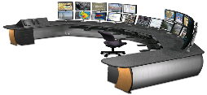











InterConnect Lab
-Operation Data Visibility: Overall-
You
Kafka broker cluster
Hypriot OS
Ubuntu Linux
Raspberry Pi
NUC
Notes:
IoT-FastData-Cloud에 기반한 Container 대응 SmartX-mini

Slide 6
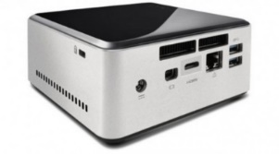





InterConnect Lab
-Operation Data Visibility: Data flow-
Timestamp, IP Address, Value1, Value2, …
Timestamp, IP Address, Value1, Value2, …
Timestamp, IP Address, Value1, Value2, …
…
Timestamp, IP Address, Value1
Timestamp, IP Address, Value1
….
Kafka Cluster
Topic 1 (Load Average)
……
Topic 2
(Memory Utilization)
Topic 3
(CPU Utilization)
Topic 4
(IO)

Slide 7
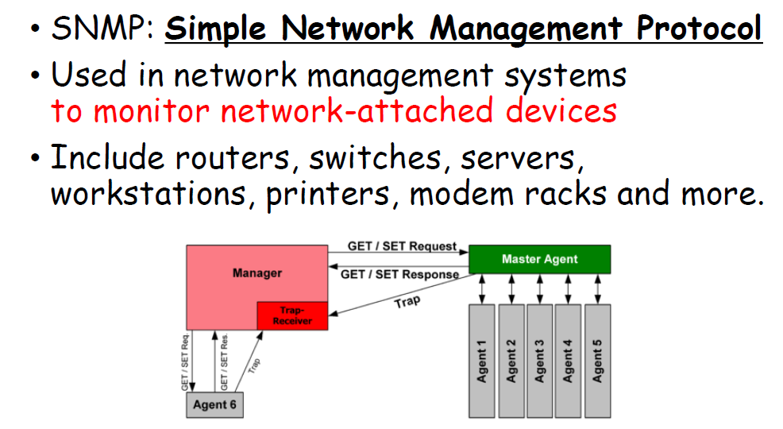
SNMP

Slide 8

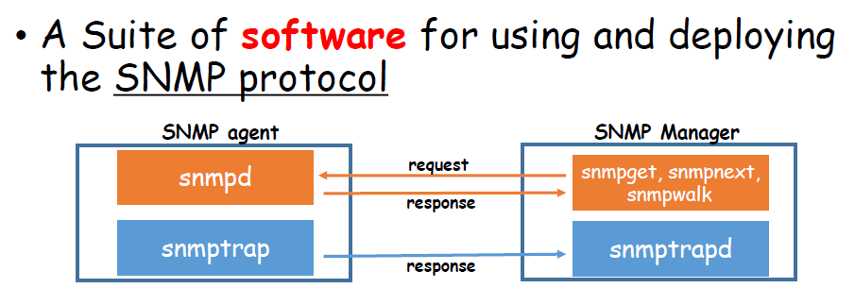
Net-SNMP

Slide 9

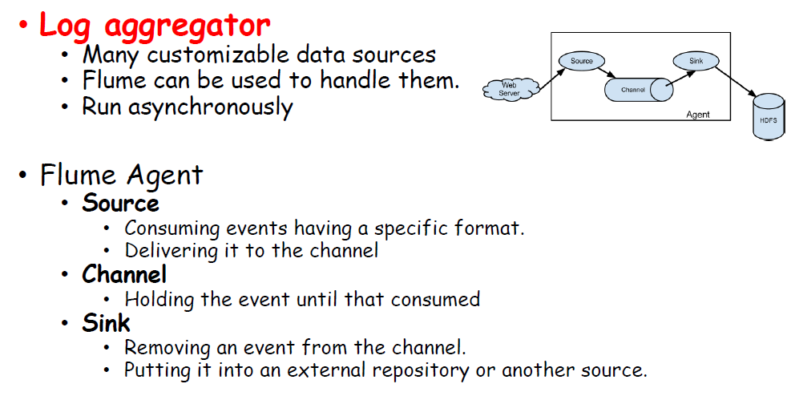
Flume

Slide 10

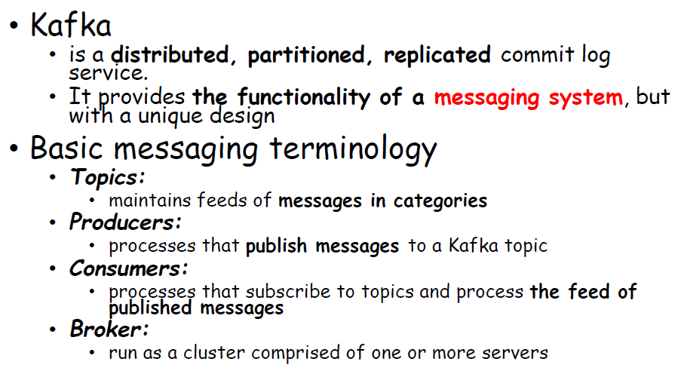
Kafka

Slide 11
Kafka: Architecture
Kafka Cluster
broker1
Producer
TCP Protocol
TCP Protocol
Consumer
Broker2
(Leader)
broker3
Zookeeper
Cluster
Notes:
http://blog.acronym.co.kr/483

Slide 12
Cont’d
Zookeeper
Producers(Pi #1)
Node 0 (Master)
Broker 0
Producers(Pi #2)
Node 1 (Slave 1)
Broker 1
Consumers
(Spark Streaming)
. . . . . . . .
Node 2 (Slave 2)
Broker 2
Node 3 (Slave 3)
Broker 3
Producers(Pi #20)

Slide 13
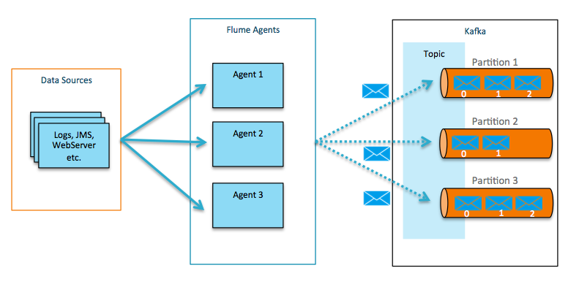
Kafka: with Flume
Flafka : Apache Flume Meets Apache Kafka for Event Processing
Notes:
http://blog.cloudera.com/blog/2014/11/flafka-apache-flume-meets-apache-kafka-for-event-processing/

Slide 14
Connecting Configuration on NUC

Slide 15
In this section
You
Kafka broker cluster
Kafka broker cluster
Hypriot OS
Ubuntu Linux
Raspberry Pi
NUC
Notes:
IoT-FastData-Cloud에 기반한 Container 대응 SmartX-mini

Slide 16

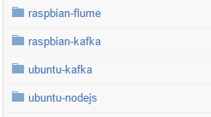
1. Download Source from Github
Download all files from Github
(http://github.com/SmartXBox/SmartX-mini_
$ git clone https://github.com/SmartXBox/SmartX-mini.git
Folder List
We’ll use it

Slide 17
2. Define a address table
We’ll use 1 zookeeper and 3 broker containers which have own public IP address
Let’s define your own address table
We’ll type these on each container
(For Example)
Host Name | IP address | Broker id | Listening port
zookeeper | 210.125.88.10 | - | 2181
broker0 | 210.125.88.20 | 0 | 9092
broker1 | 210.125.88.21 | 1 | 9092
broker2 | 210.125.88.22 | 2 | 9092

Slide 18
3-1. Build Docker
Build Docker Part
$cd ~/SmartX-mini/ubuntu-kafka
Build Dockerfile ※ It takes long time.
$ docker build --tag ubuntu-kafka .
$ If you want to check docker instruction word
$ docker --help
ex) docker ps : List containers
docker start : Start one or more stopped containers
docker rm : Remove one or more containers

Slide 19
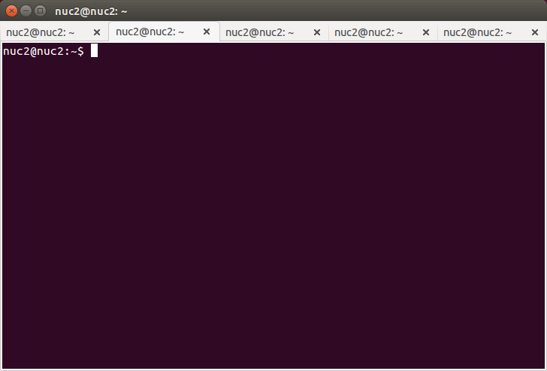
3-2. Run Docker (recommend making new terminal window)
Run Docker Part
Run Docker Container
$ docker run -it --net=none –h [host name] --name [container name] ubuntu-kafka
If you want to look for more details about Docker command, see https://docs.docker.com/reference/commandline/
When you make new terminal, you just
press 'ctrl + shift + t', then you can make
multiple terminals like taps.
Also, you want to change tap name,
press right mouse button and select set titles.

Slide 20
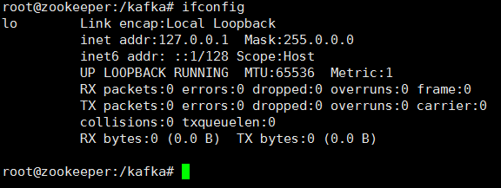
4-1. Allocate IP address on Container
Let’s check the present status
$ifconfig
Go out from container
(Ctrl+P)(Ctrl+Q)
Adding bridge port for container’s interface
$ sudo ovs-docker add-port br0 eth0 [container name] --ipaddress=[container ip address]/24 --gateway=[gateway address]
// if you have a problem about setting ipaddress, use this command.
$ sudo ovs-docker del-ports br0 [container name]

Slide 21
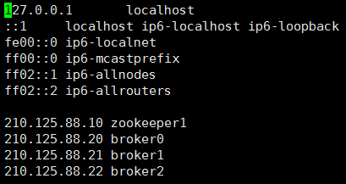
4-2. Edit /etc/hosts
Every machine which Kafka runs on must know all of their host name with IP address.
Go into container
$docker attach [container name]
Edit /etc/hosts
$ sudo vi /etc/hosts
(For Example)
[host name] (O)
[container name] (X)

Slide 22
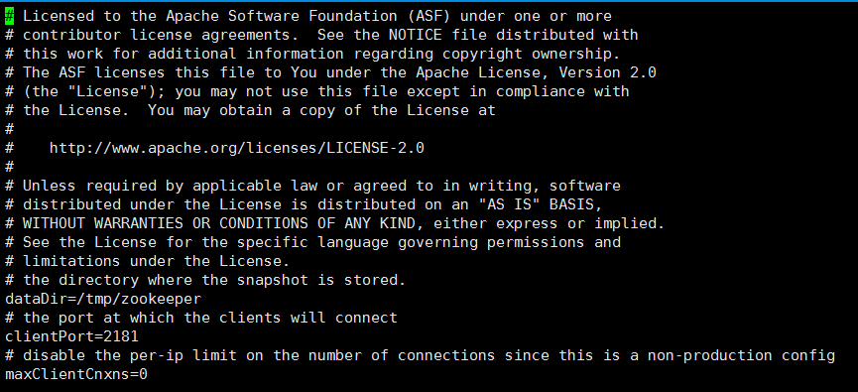
5-1. Configure Zookeeper properties
Actually we use default configurations
Open zookeeper properties file
$vi config/zookeeper.properties
Check the client port

Slide 23
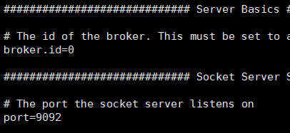
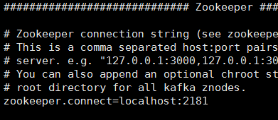
5-2. Configure Kafka properties
Open server properties file
$vi config/server.properties
Editing proper broker id (it must be unique) and zookeeper address
Check the port number
broker id
zookeeper address

Slide 24
Follow the same procedures (3-2 ~ 5) for every container (zookeeper 1, broker 3)

Slide 25
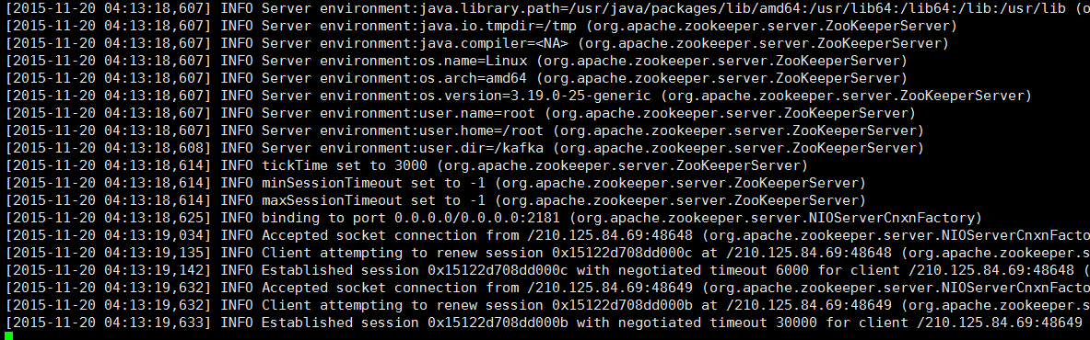
6. Launching Zookeeper node
zookeeper must launch first
$bin/zookeeper-server-start.sh config/zookeeper.properties
Zookeeper address
Zookeeper address
Zookeeper address
Zookeeper address
Zookeeper address
Zookeeper address

Slide 26
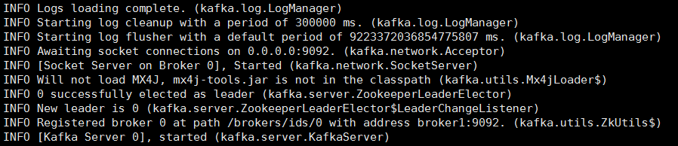
7. Launching Kafka brokers
Attach into each kafka broker container and run scripts to launch
$bin/kafka-server-start.sh config/server.properties

Slide 27
8. Making Consumer container
Making new kafka container for consumer
$docker run -it --net=host --name [container name] ubuntu-kafka
Set /etc/hosts as other kafka brokers’
Host Name | IP address | Broker id | Listening port
zookeeper1 | 210.125.88.10 | - | 2181
broker0 | 210.125.88.20 | 0 | 9092
broker1 | 210.125.88.21 | 1 | 9092
broker2 | 210.125.88.22 | 2 | 9092

Slide 28
9. Making topic on Consumer
Create topic
$ bin/kafka-topics.sh --create --zookeeper [zookeeper host name]:2181 --replication-factor 1 --partitions 3 --topic <topic_name>
We can check topics’.
topic List
$ bin/kafka-topics.sh --list --zookeeper <zookeeper host name>:2181
topic specification
$ bin/kafka-topics.sh --describe --zookeeper <zookeeper host name>:2181 --topic <topic_name>

Slide 29
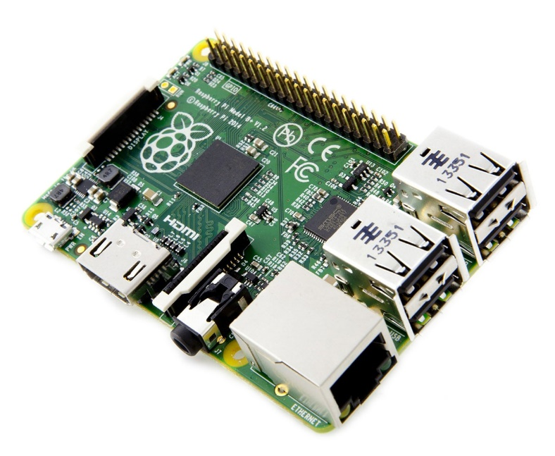
Connecting Configuration on Raspberry Pi

Slide 30
In this section
You
Kafka broker cluster
Hypriot OS
Hypriot OS
Ubuntu Linux
Raspberry Pi
NUC
Notes:
IoT-FastData-Cloud에 기반한 Container 대응 SmartX-mini

Slide 31

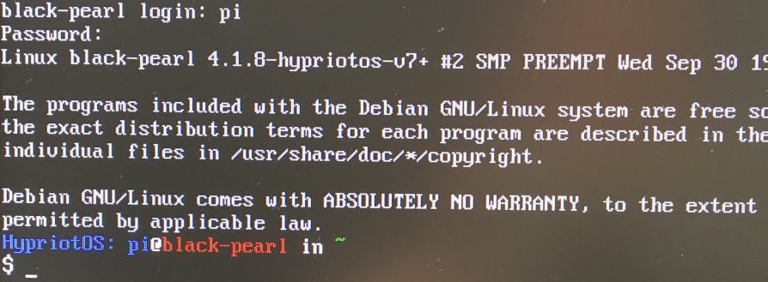
0. Before Setting
Hypriot
Raspberry Pi OS
To run docker
Cf) Raspbian Jessie
32bit OS -> It can’t run docker
Therefore we must use Hypriot OS.
Detailed Information about Raspberry Pi & hypriot, you can check Appendix.

Slide 32
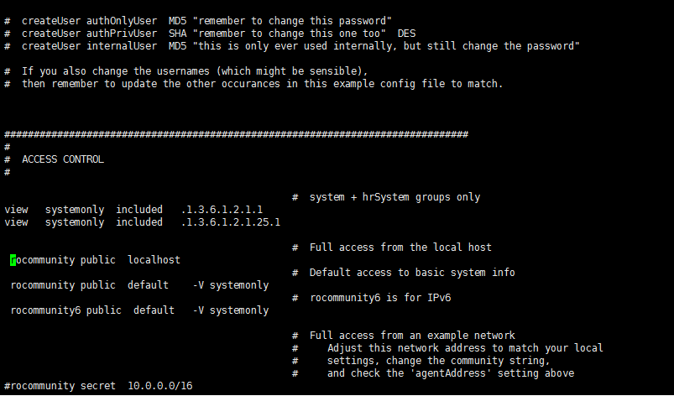
1. Install Net-SNMP
$ sudo apt-get update
Download Net-SNMP
$ apt-get install –y snmp snmpd
Download and apply mibs
$ apt-get install –y snmp-mibs-downloader
$ download-mibs
Modify configuration file
$ vi /etc/snmp/snmpd.conf
#rocommunity public localhost -> Delete #
$ /etc/init.d/snmpd restart

Slide 33
2. Download Source from Github
Git package is already installed in Hypriot OS
Download all files from Github
(http://github.com/SmartXBox/SmartX-mini_
$ git clone https://github.com/SmartXBox/SmartX-mini.git
Folder List
We’ll use it

Slide 34
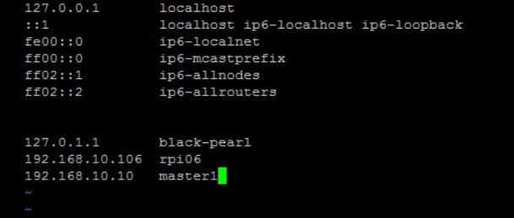

3. Edit /etc/hosts
Adding raspberry pi and nuc’s host name and ip address
-> we can see host name $ hostname
Also add zookeeper, broker host name and ip address
$ sudo vi /etc/hosts

Slide 35
4. Install Flume on RPi
Build Dockerfile
※ It takes long time
$ cd SmartX-mini/raspbian-flume
$ docker build --tag raspbian-flume .
$ docker run –it --net=host raspbian-flume
2) Modify configuration file
$ vi conf/flume-conf.properties
We modify this.
agent.sinks.sink1.topic=[topic_name]
agent.sinks.sink1.brokerList=[broker_ipaddress:port]

Slide 36
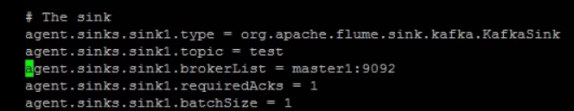
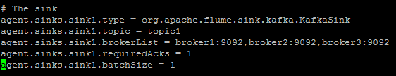
Cont’d

Slide 37
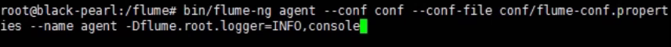
4. Run Flume Agent
Run Flume on RPi
$ bin/flume-ng agent --conf conf --conf-file conf/flume-conf.properties --name agent -Dflume.root.logger=INFO,console

Slide 38
Result

Slide 39
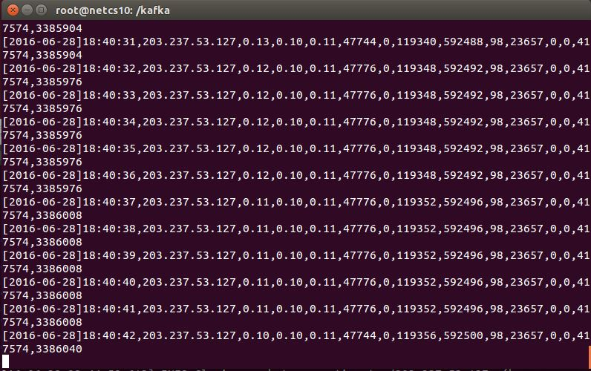
Consuming message from brokers
Launch consumer script and Result
$bin/kafka-console-consumer.sh --zookeeper [zookeeper host name]:2181 --topic [topic name] --from-beginning

Slide 40
Default Message Format in SmartX-mini
Kafka message value format
ex) [2016-06-28]18:40:33,203.237.x.x,0.12,0.10,0.11,47776,0, ...
Monitoring Item numbers
CPU : user(0), nice(1), system(2), iowait(3), steal(4), idle(5)
Memory : total(6), free(7), buffer(8), cached(9)
Storage : tps(10), kbReads(11), kbWrtns(12), kbRead(13), kbWrtn(14)
Network : ttl(15), latencyTime(16)
Timestamp | IP address | Monitoring item number | Monitoring item value

Slide 41
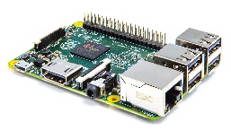
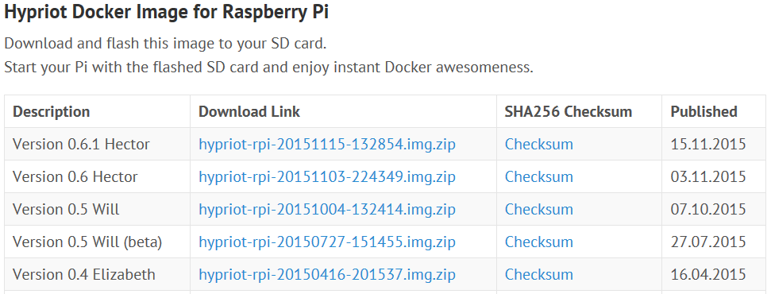
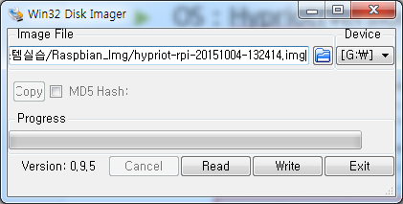
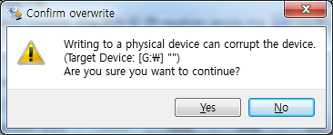
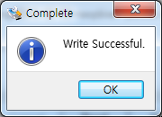
Raspberry Pi2 OS Setting
OS : Hypriot(Version : 0.5 Will, 07.10.2015 published)
Download Site : http://blog.hypriot.com/downloads/
압축을 푼 후 파일(hypriot-rpi-20151004-132414.img, 1.39Gb)은 SD Writer 를 이용하여 Write.
SD Writer Download : https://sourceforge.net/projects/win32diskimager/files/latest/download?source=navbar

Slide 42

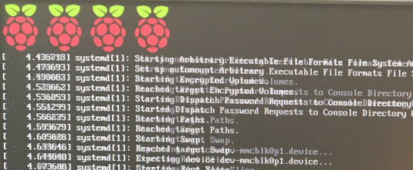
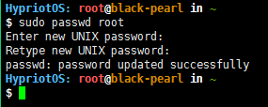
Raspberry Pi2 Environment Setting
Micro SD 카드에 Hypriot 설치가 완료되면 Pi2에 삽입 후 부팅
Root password 변경
package 설치, RPM upgrade, 시스템 관리를 위해 필요
password 입력시 * 표시가 나오지 않지만 입력되고 있으니 걱정하지 말 것
root password는 꼭 기억할 것!!!
login ID인 pi 계정의 password 도 변경하도록 하자.
loading 화면
CUI 환경으로 부팅되면 성공
Login ID : root
Password : hypriot
$sudo passwd root
$passwd

Slide 43


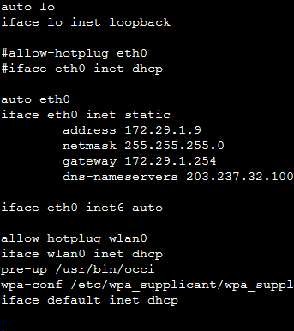
NUC & Pi2 IP address Setting
Pi2 IP address 설정을 위해 필요한 파일(편집은 root 만 가능)
/etc/network/interfaces
일반적으로 dns-nameservers 를 입력하면 45 page 는 필요 없으나, Hypriot OS 는 삽입되지 않으므로 resolv.conf 파일에 직접 nameserver를 입력해야 함!
$cd /etc/network
$sudo vi interfaces
#iface eth0 inet dhcp ← # 은 주석
auto eth0
iface eth0 inet static
address 172.29.0.X ← ip address
netmask 255.255.255.0 ← subnet mask
gateway 172.29.0.254 ← Gateway
dns-nameservers 203.237.32.100 203.237.32.101
입력 예

Slide 44
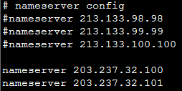

NUC & Pi2 IP address Setting
Pi2 IP address 설정을 위해 필요한 파일
/etc/resolv.conf
기존의 nameserver는 #을 추가하여
주석처리
$cd /etc/
$sudo vi resolv.conf
$sudo /etc/init.d/networking restart 입력 또는 rebooting 후 network 확인
$sudo reboot (rebooting command)
# nameserver config
nameserver 203.237.32.100
nameserver 203.237.32.101

Slide 45
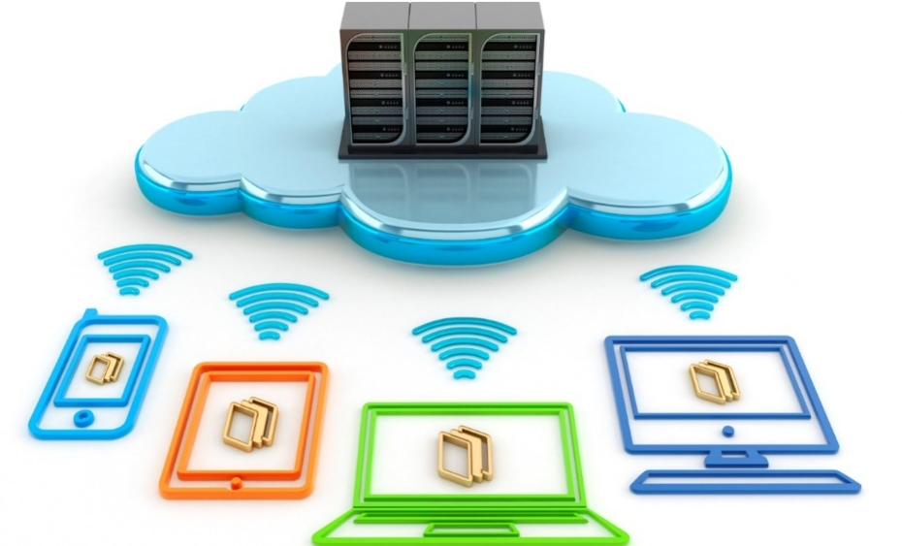
Thank You for
Your Attention
Any Questions?

